Slide 1
Gjerdrum landslide
Notes:
20 Dec deliver

Slide 2
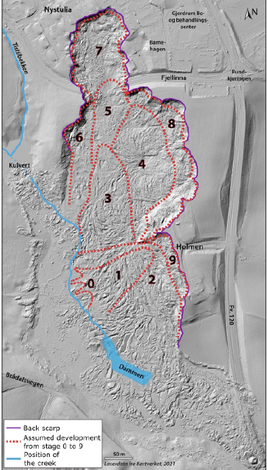
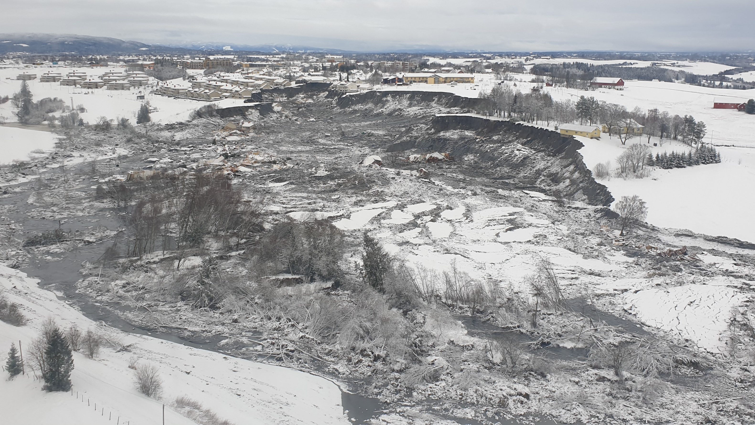
3D simulation of Gjerdrum landslide
- Where: Gjerdrum, Norway
- When: 4 a.m. on 30th December 2020
- Casualty: 10
- Volume: 1.35M m³
- Retrogressive distance ~ 630m

Slide 3
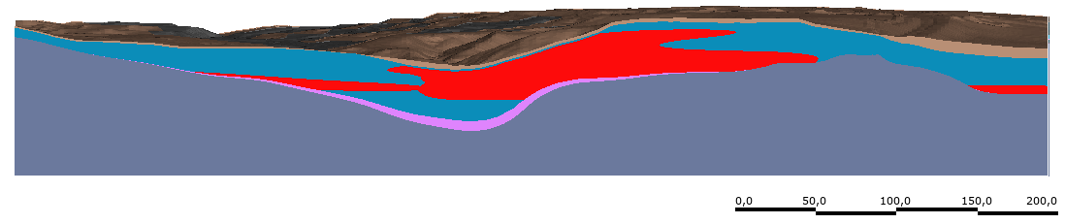
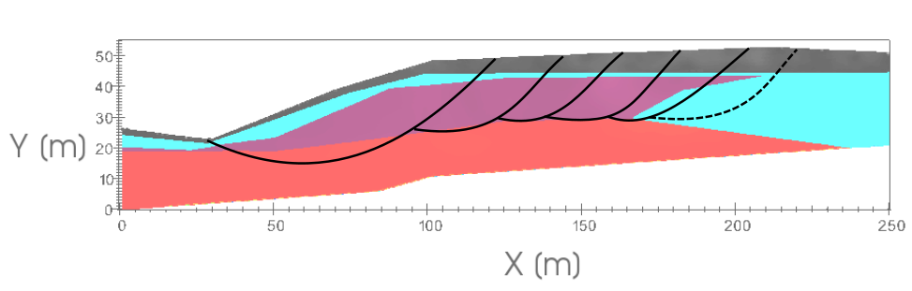
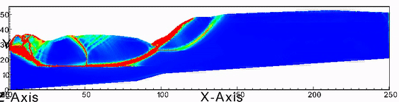
2D analysis provides value insights in landslide mechanism
Yes, but reality is 3D and
2D yields different results from 3D

Slide 4
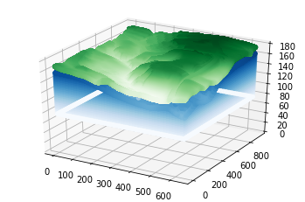
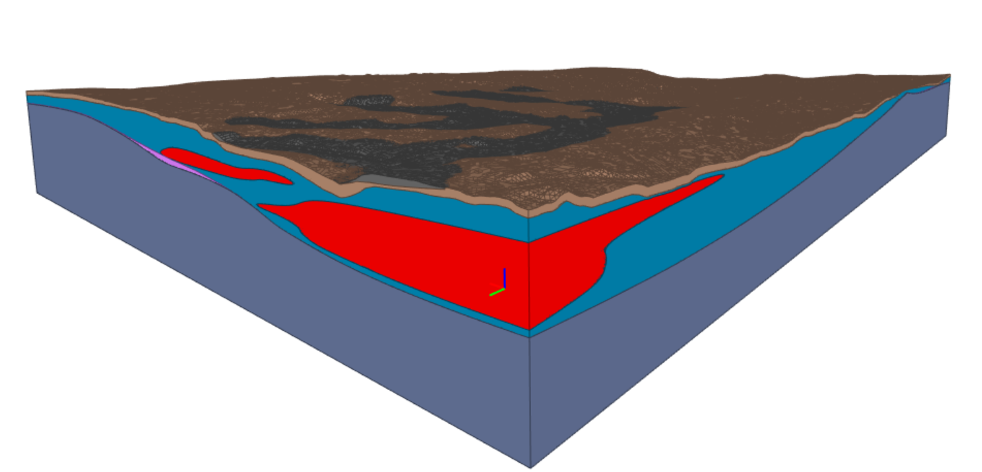
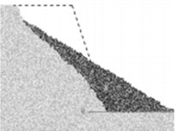
Can we simulate sensitive clay landslide in 3D?
3D simulation
3D Terrain and layers
3D Soil properties
Advanced modeling
Material Point Method

Slide 5
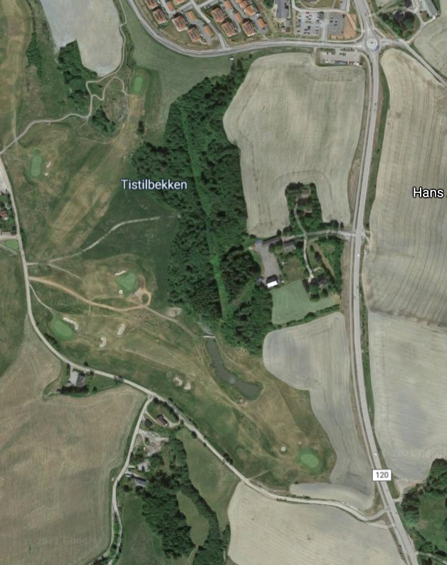
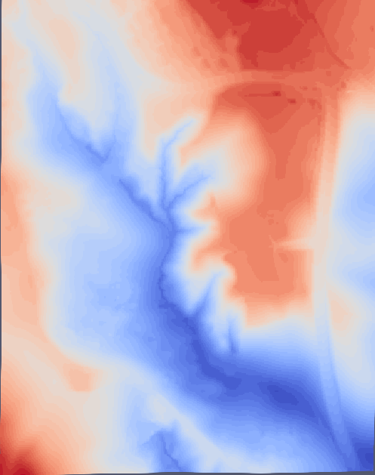
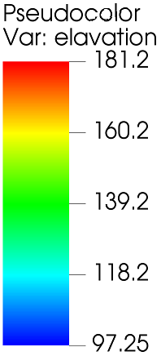
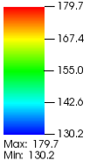
From Digital terrain model to numerical model
3D terrain reconstruction

Slide 6
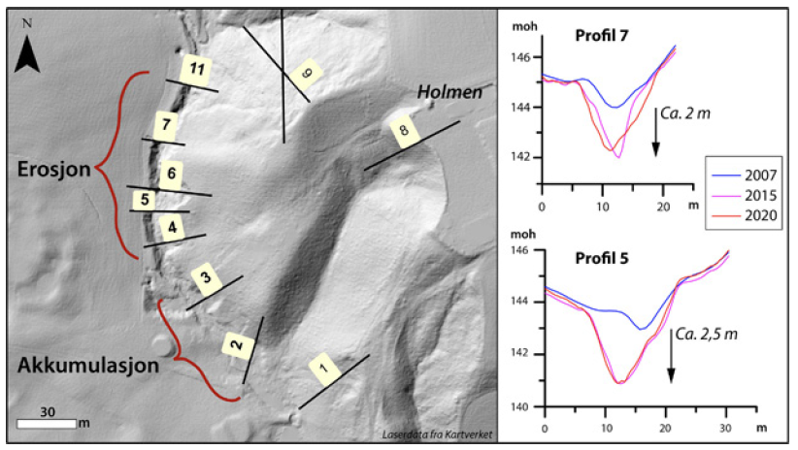
Triggering mechanism: errosion?

Slide 7
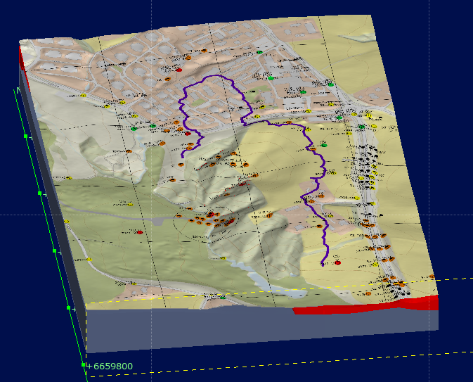
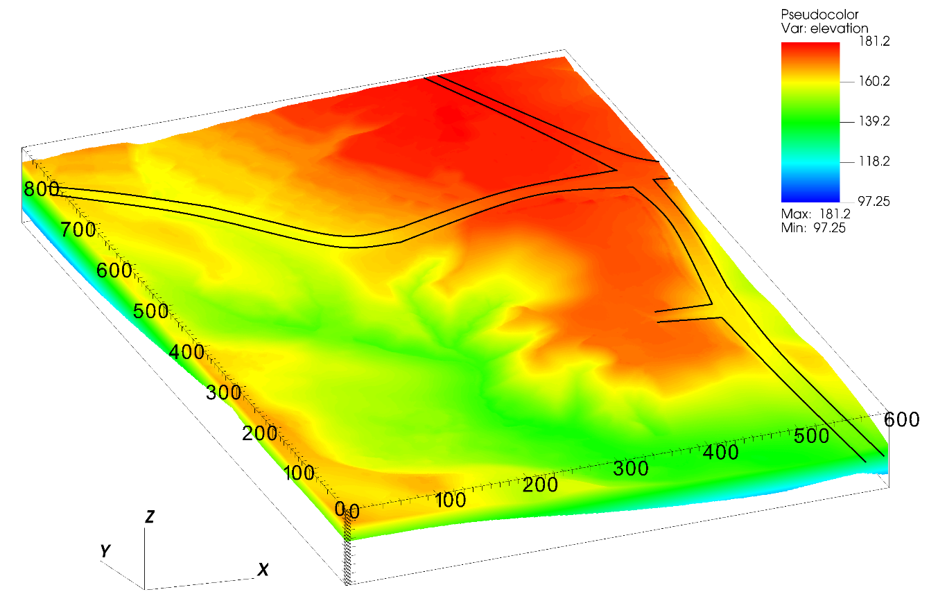
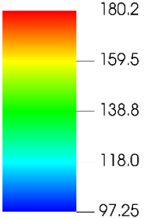
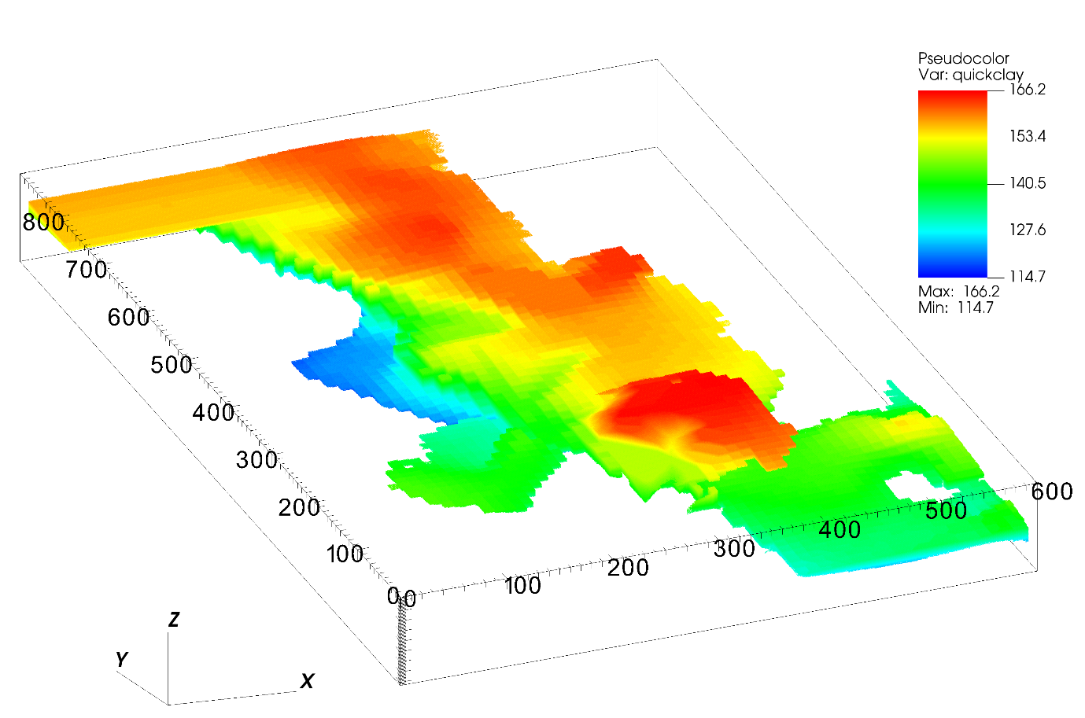
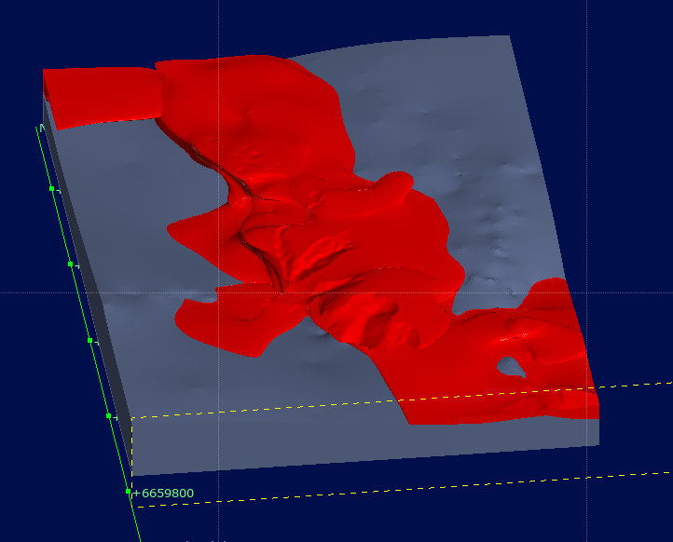
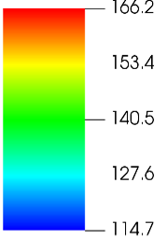
Terrain elevation
Quick clay elevation

Slide 8
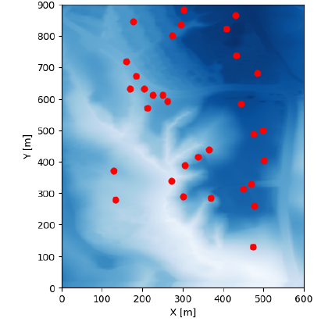

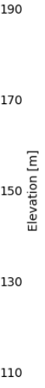
3D soil parameters
Data obtained from CPTUs
3D data of the undrained shear strength is interpolated using radial linear basis function

Slide 9
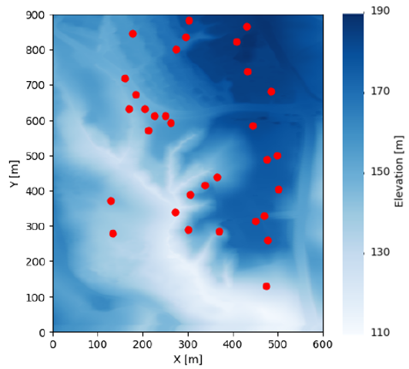
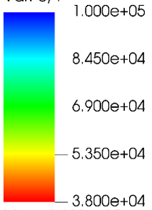
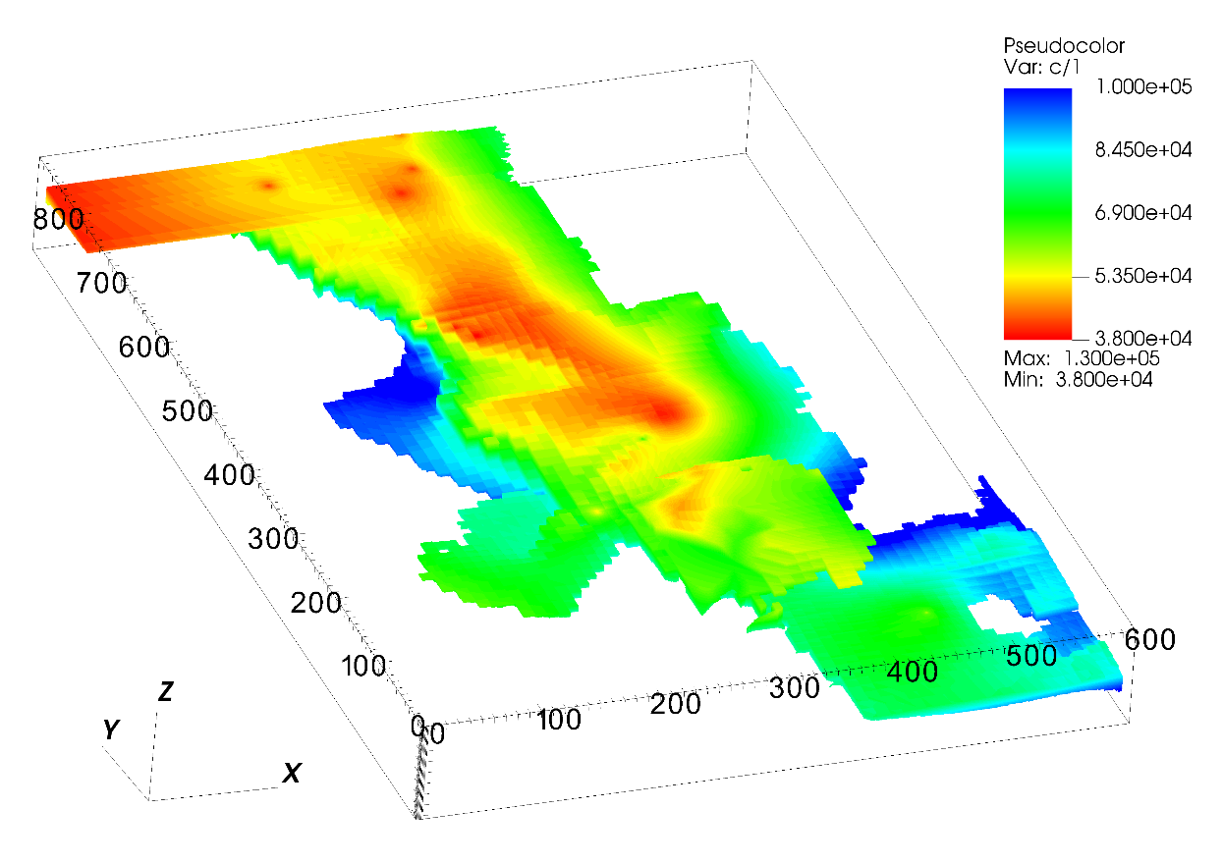
CPTUs Borehole location
Undrained shear strength of quick clay layer
kPa
100
85
69
53
38

Slide 10
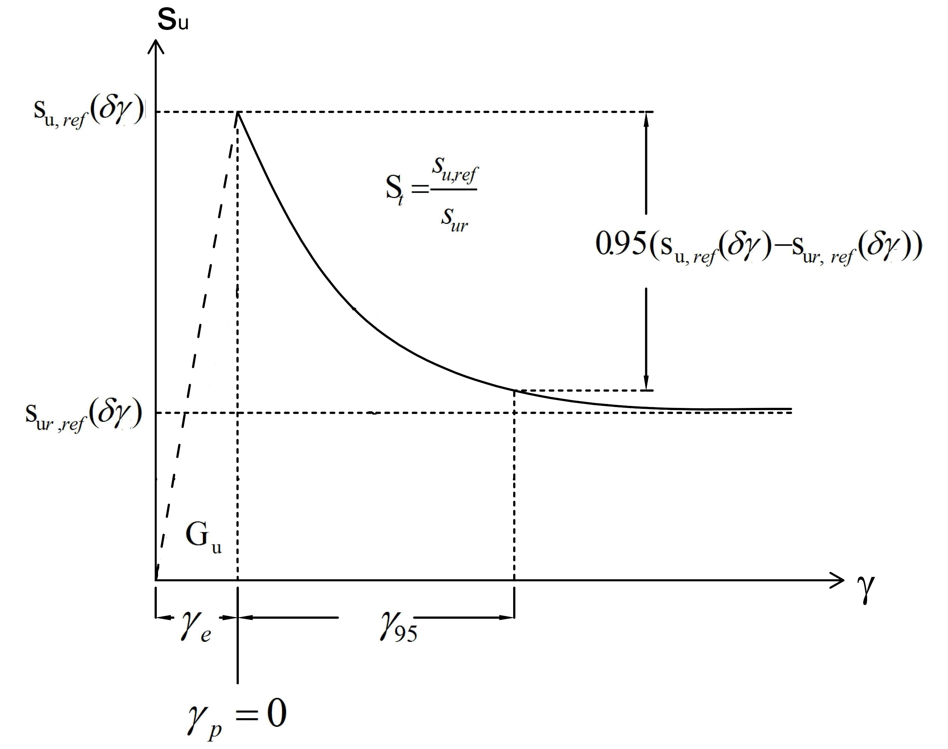
Constitutive soil model
Parameter | Clay | Quick clay
Peak strength | CPTu | CPTu
Residual strength | 10 kPa | 0.5 kPa
Gamma_95 | 20%

Slide 11
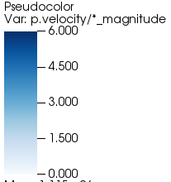
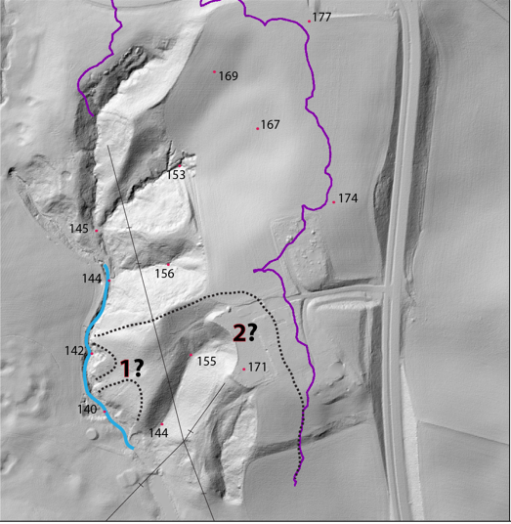
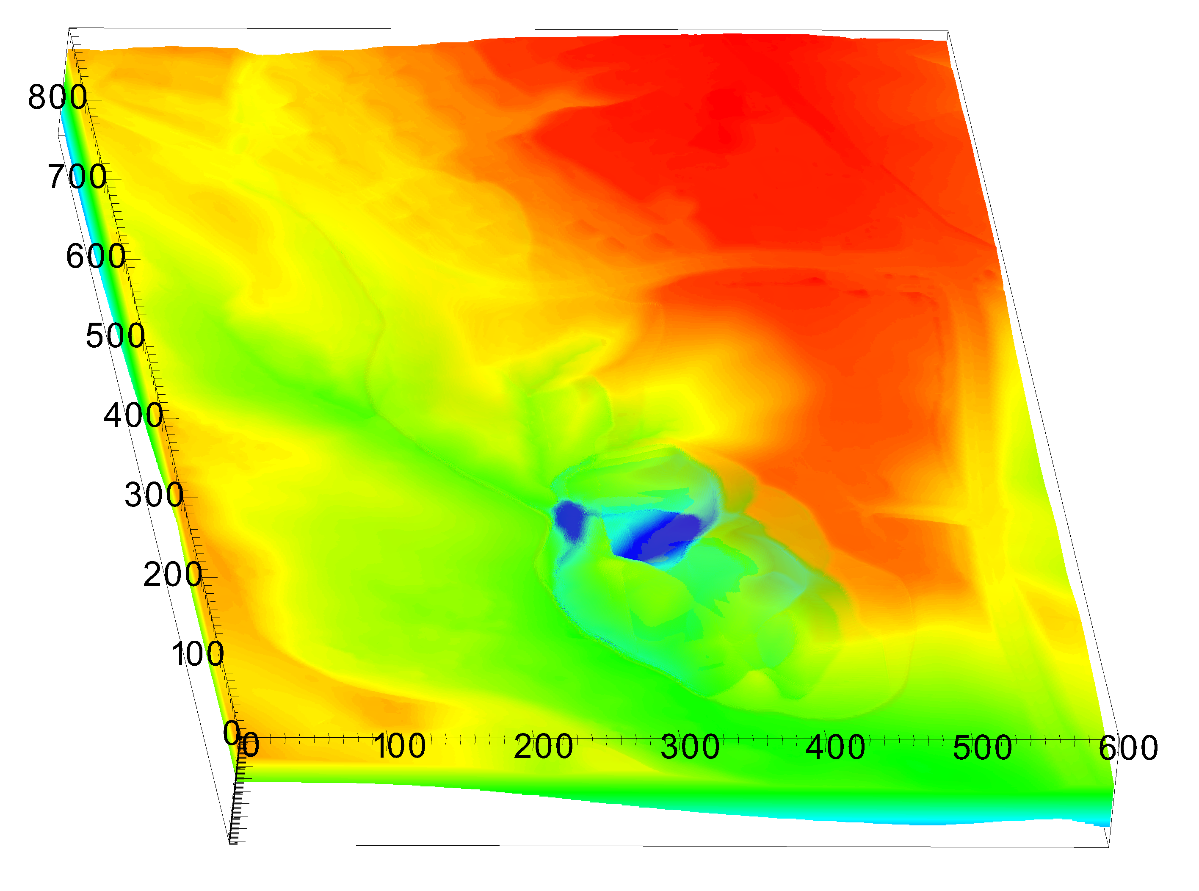
Stage 1 of the slide
Velocity
First
slide

Slide 12
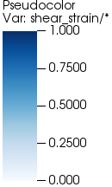
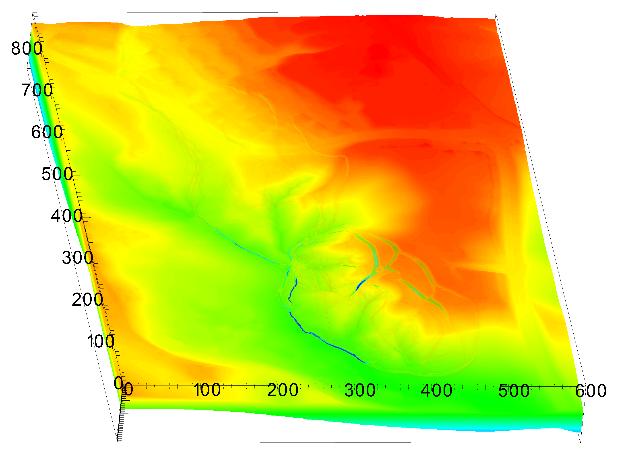
Stage 1 of the slide
Shear strain
Shear
band

Slide 13
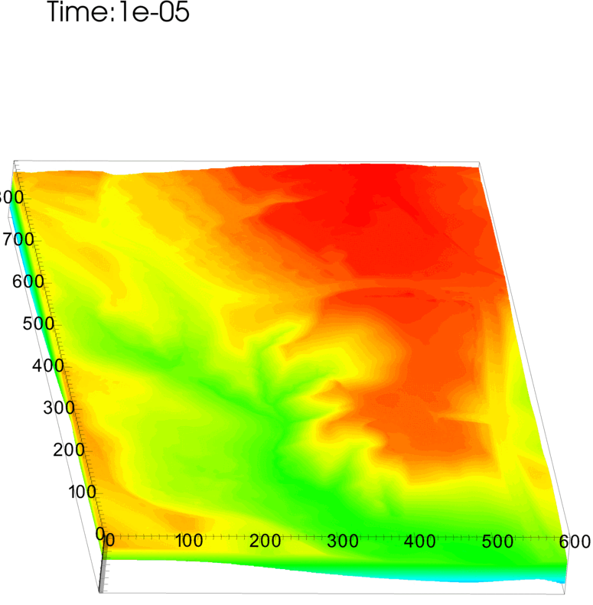
Shear strain

Slide 14
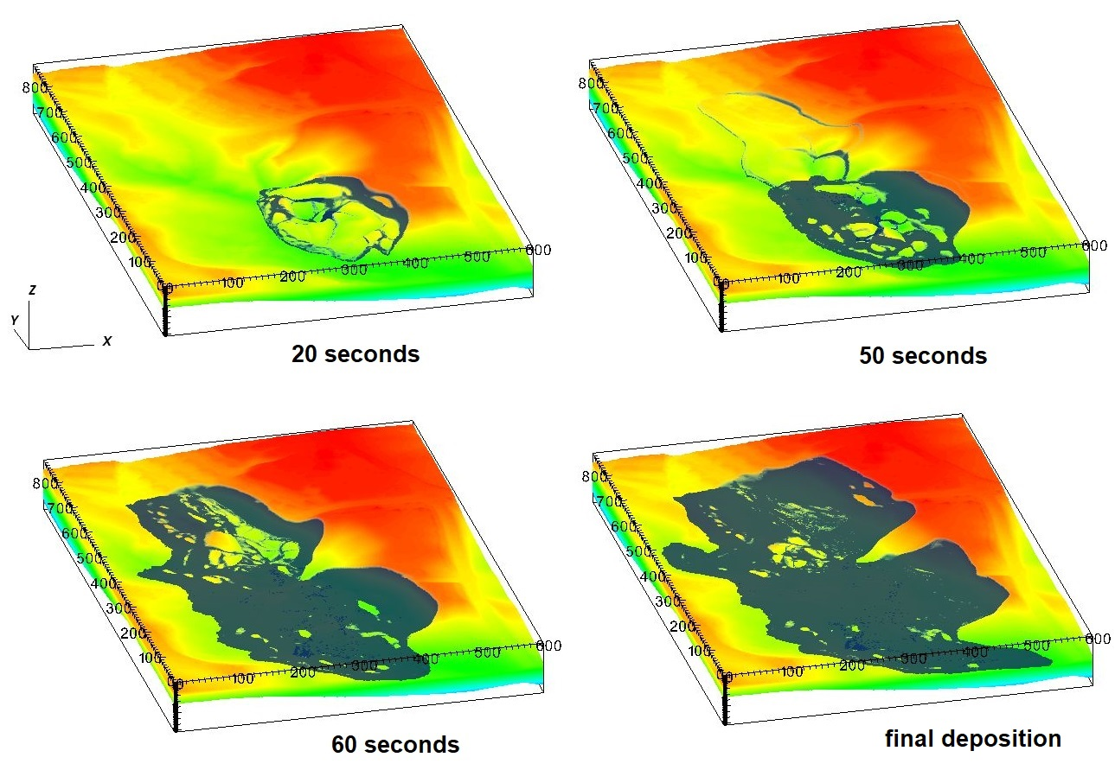
Simulation

Slide 15
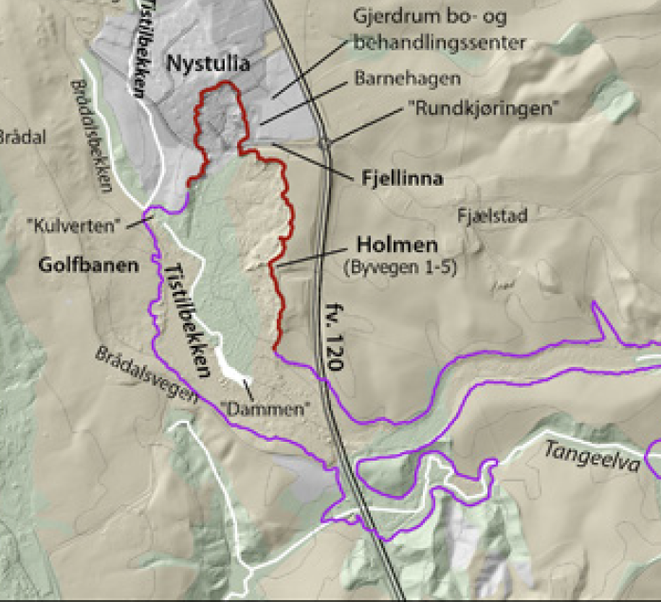
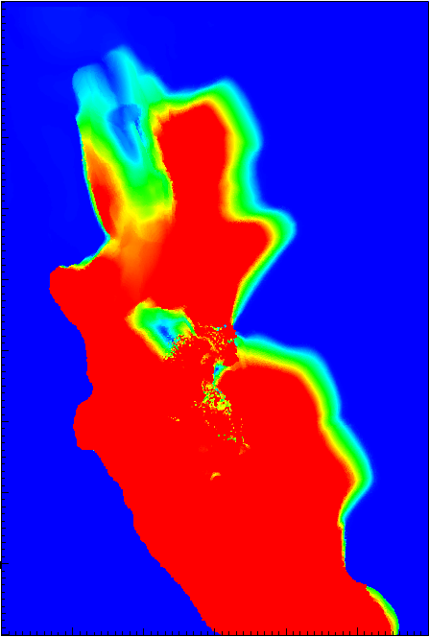
Numerical prediction of retrogressive distance

Slide 16
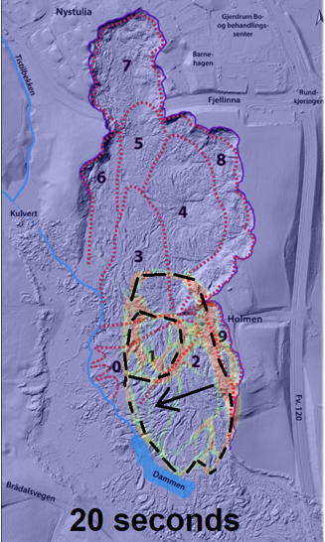
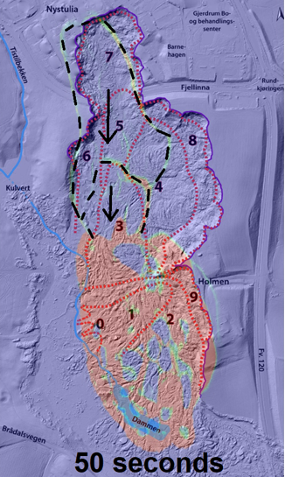
Propagation of the shear band

Slide 17
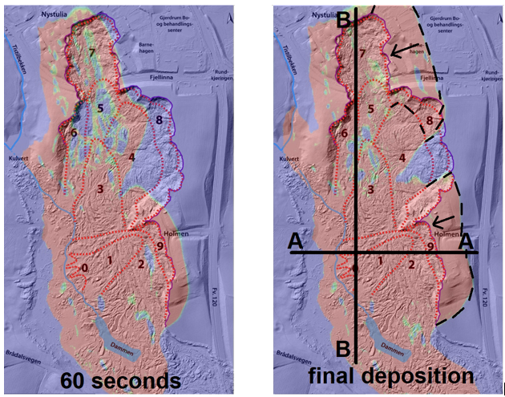
Propagation of the shear band

Slide 18
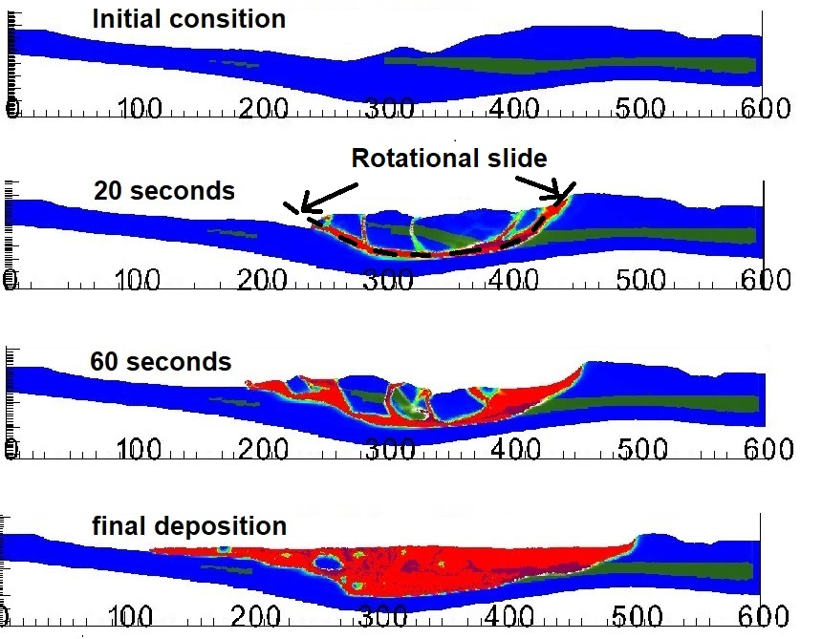
Cross section A-A

Slide 19
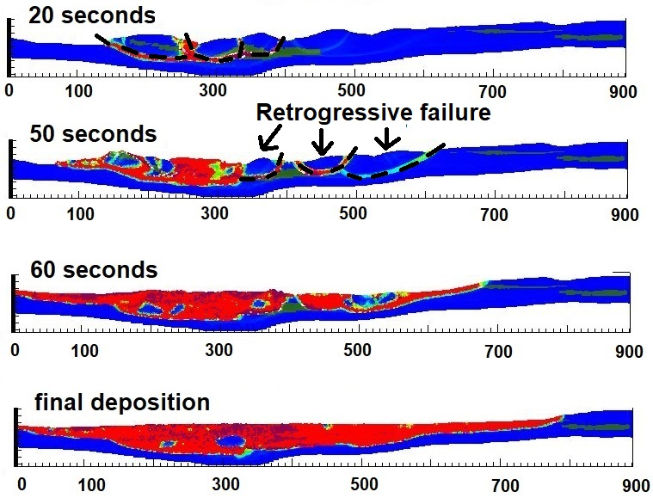
Cross section B-B

Slide 20
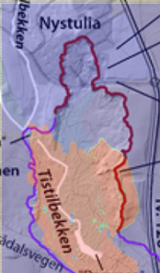
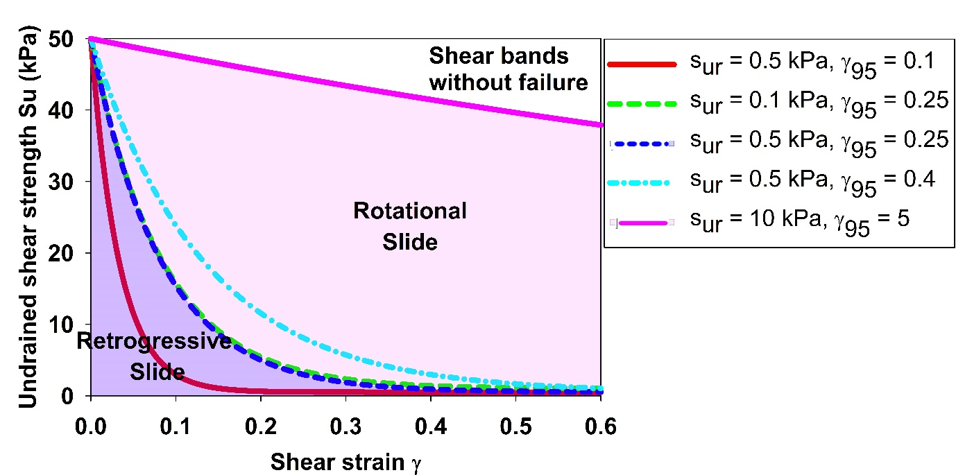
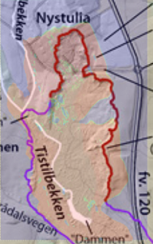
Influence stress strain on retrogressive distance

Slide 21
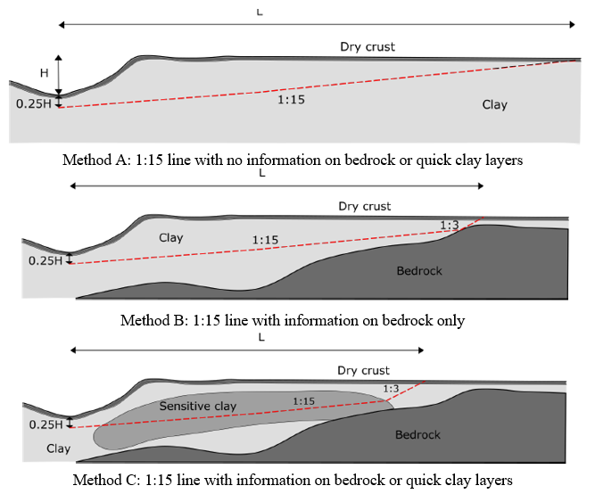

Slide 22
